Slide 1
Customer Segmentation
Presented by : BOWTHIRAN

Slide 2
Business Problem :-
Ads and promotions are targeting the wrong audience, leading to low engagement and wasted ad spend, Company loses 15% of marketing budget due to poor targeting.
Customers stop purchasing or switch to competitors, causing 30% revenue drop.
Irrelevant recommendations result in low product engagement and 15% lower sales.
Prices are too high for budget customers or too low for premium buyers, leading to the revenue lost 20%.
Overstocking increases holding costs, it leads to lost sales, causing a 25% revenue drop.

Slide 3
Current solution :-
Mass Offers to All Customers, 40% Budget Wasted.
Same Ads for All Customers, 30% Lower Engagement.
Slow & Generalized Customer Support, 10% Lower Satisfaction.
Random Pricing Strategy, 25% Profit Loss.

Slide 4
Proposed solution :-
Targeting the right customers, Marketing efficiency improved by 50%
Personalized ads based on spending habits, Increased engagement 30%
Reduced customer churn and get 25% More Retention.
Demand forecasting by segment, Stock availability aligned based on demand increase 25% revenue.

Slide 5
Dataset :-
unwanted data is available (customerid).
This data is more then enough, but product category, feedback score, complaints will improve the model prediction.
This business problem we will use cluster algorithms like Kmeans, DBSCAN.

Slide 6
EDA (Exploratory Data Analysis) :-
Univariate Analysis (Distribution of single variables)
Bivariate Analysis (Relationship between two variables)
Multivariate Analysis (Patterns across multiple variables)

Slide 7
Data Preprocessing :-
Remove duplicates (Duplicated(), Drop_Duplictes())
Handle missing values. (Fillna(), Ffill(), Bfill(), Dropna())
Indentify the outliers and remove. (IQR, z - score, boxplot, scatterplot)
Feature Scalding (Standardization)
Encoding Categorical values (One-hot-encoding).

Slide 8
Feature Selection :-
Remove multicollinearity feature’s using corr().
Select the Feature values for model training.
Algorithm Selection :-
train with cluster algorithms and find the best algorithm for this business problem.
Finally choose the best algorithm with tunning and check with best silhouette_score.
silhouette_score (Kmeans – 0.29, DBSCAN – 0.27)

Slide 9
Insights :-
Males have a slightly higher average annual income than females.
Females have a slightly higher spending score than males.
Cluster 2,3 has the highest spending scores, indicating high value customers.
Clusters 0,1 have lower spending scores, representing budget conscious or low engagement customers.
annual income 200000 to 1200000 lacs will spend 0 to 30 also some people spend 65 to 100 annual income 600000 lacs will spend 40 to 60.

Slide 10
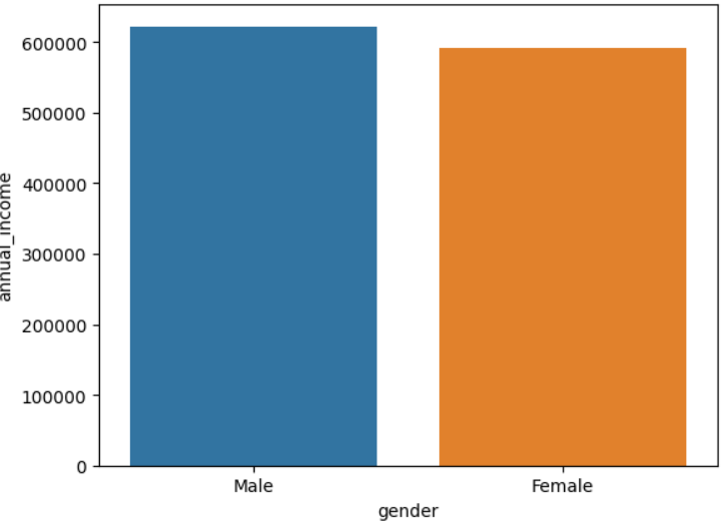
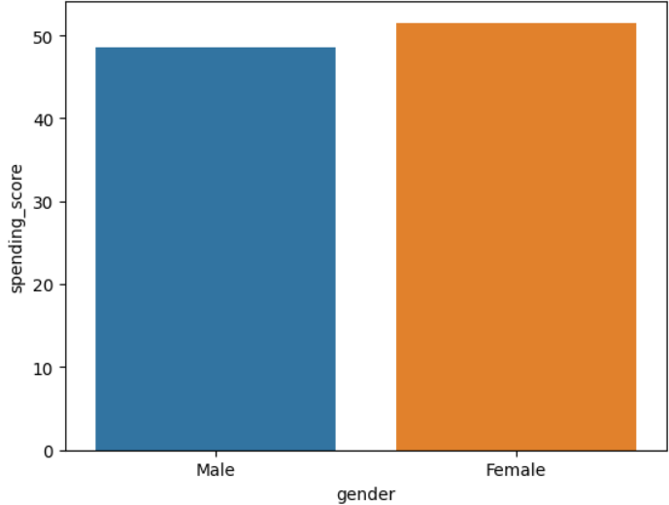
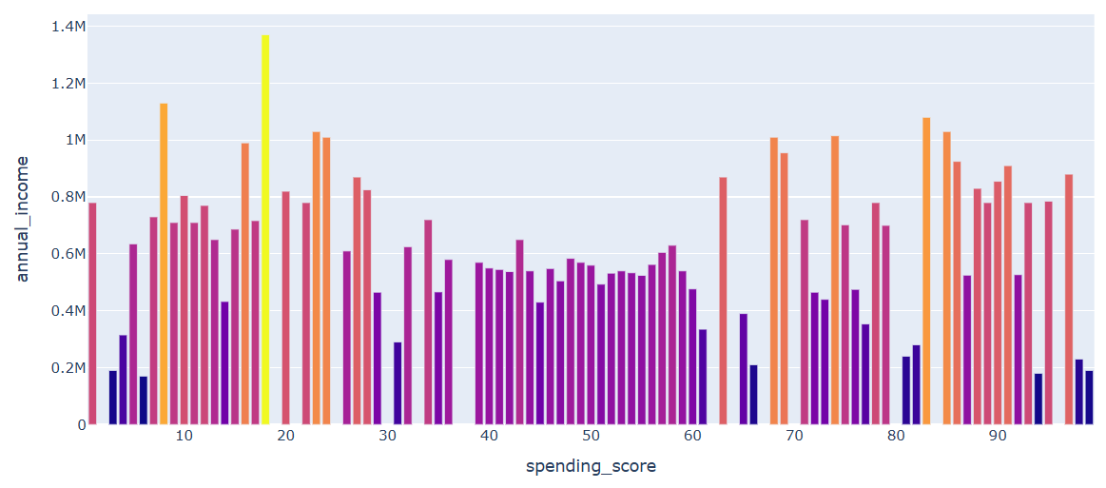

Slide 11
